Slide 1
Backend & Database

Slide 2
Repository Link
https://github.com/RuslanPidhainyi/ITCorporation

Slide 3
Contents
Backend
.Net( C#/ASP.Net )
Backend
Database
IDE (Visual Studio)
Client-Server architecture
Request/Response HTTP
Swagger

Slide 4

Backend

Slide 5

.NET
.NET is a platform that allows you to create and run applications in various programming languages, such as C#, F#, and VB.NET.
.NET is a cross-platform technology that allows it to be used on different operating systems, such as:
Windows
macOS
Linux

Slide 6
What is C# ?
C# is a compiled, high-level, and object-oriented programming language that runs on the .NET platform.
C# is also a cross-platform language, which allows us to use it in various areas of development.
For example:
Mobile applications
Web services
Games
And more
For this, there are various frameworks: .NET MAUI, ASP.NET, Unity, and others.

Slide 7
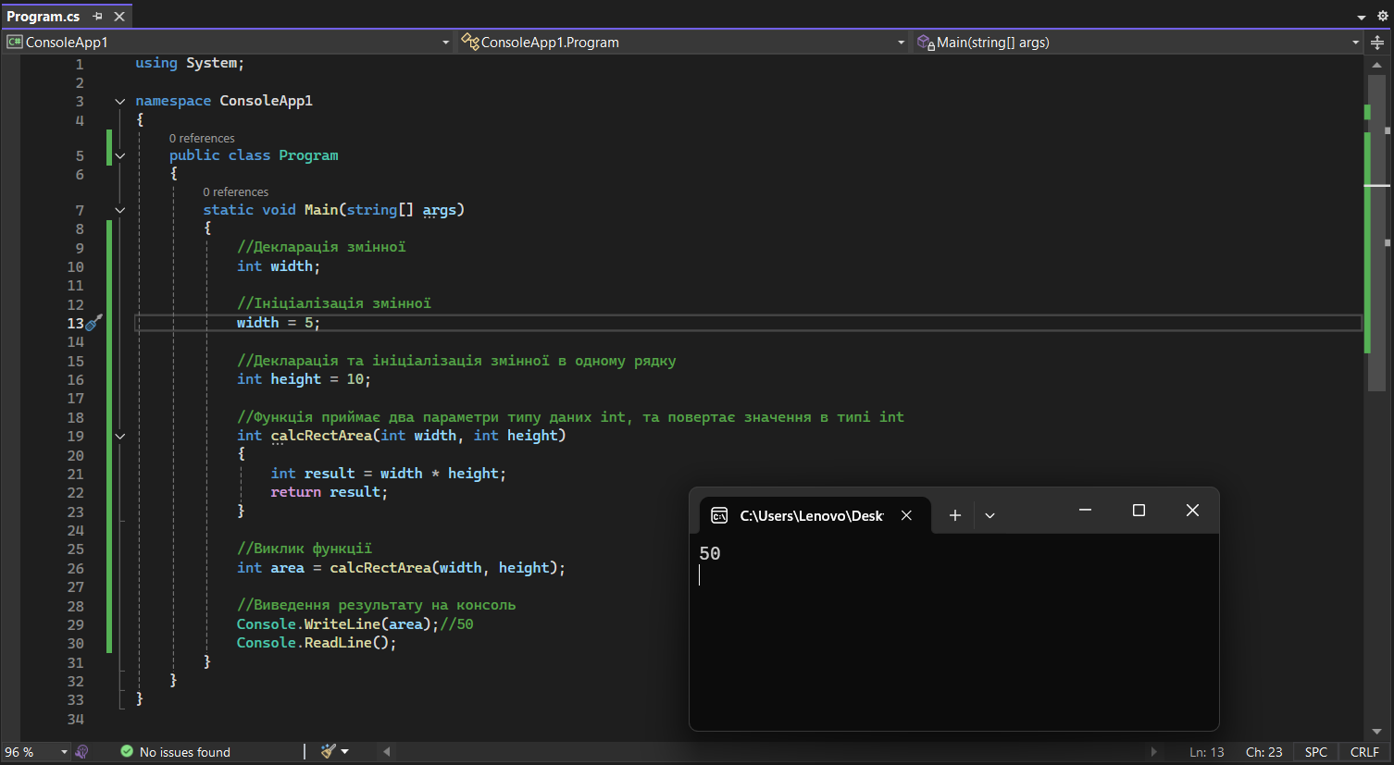
C# Syntax
Syntax is a structure or set of rules that describe how to correctly use specific constructs of a programming language.

Slide 8
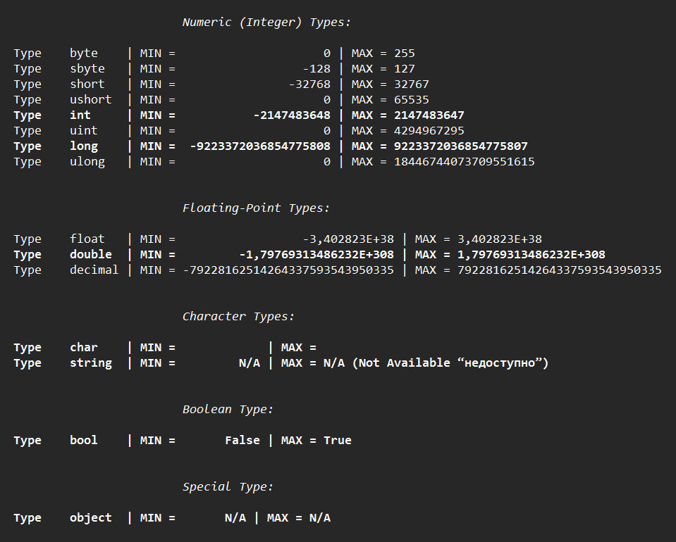
Data types
C# is a strictly typed programming language, which means strict adherence to data types. Data types help store certain information, and each of them has a defined amount of memory that we can use.
Classification of data types:
Numeric / Integer types — whole numbers
Floating-point types — floating-point numbers
Character types — characters and text
Boolean type — logical data type
Special type — objects. Objects can be classes, interfaces, delegates, etc.

Slide 9
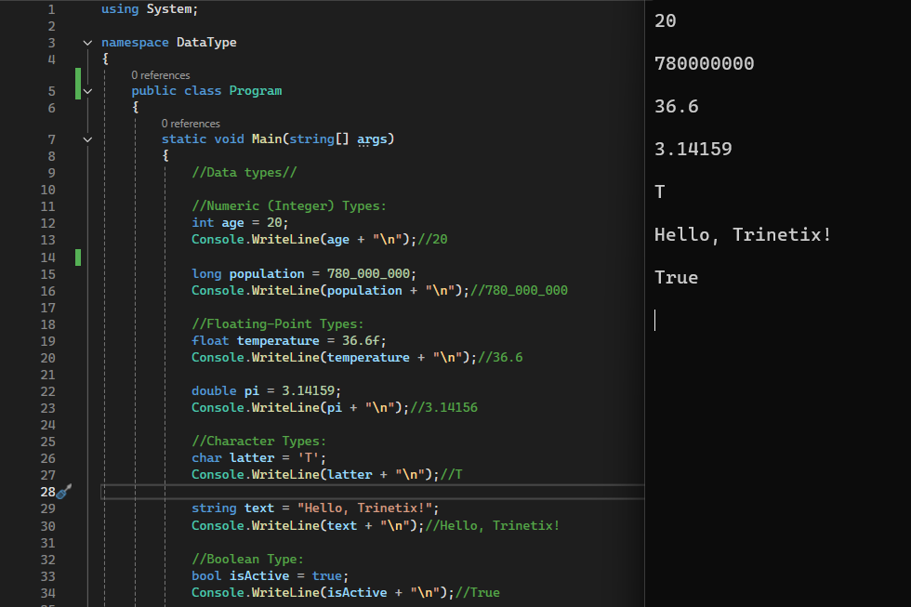
Code: Data types

Slide 10
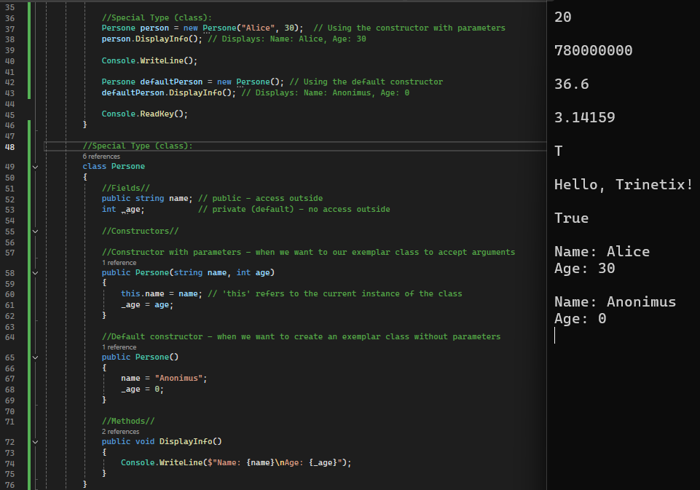
Code: Data types

Slide 11
Types: Value and Reference
Data types
Value types
Reference types
(s)byte
(u)int
(u)short
(u)long
float
double
decimal
char
bool
This slide is mostly in English. The only Ukrainian text is the description under Reference types:
string
array (int[], double[,])
class
interface
delegate

Slide 12
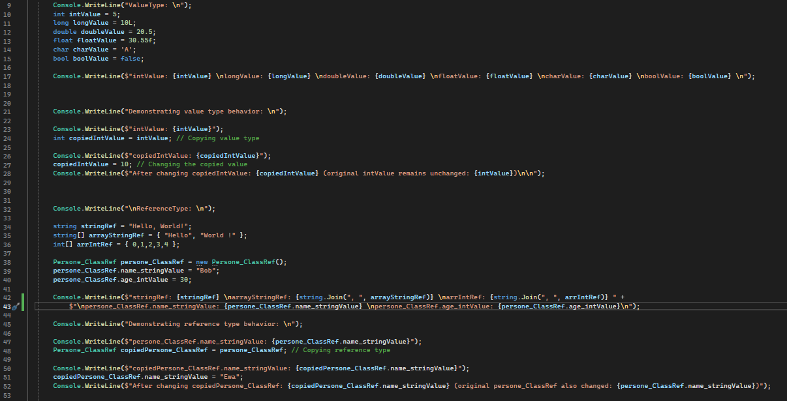
Code: Value types & Reference types

Slide 13
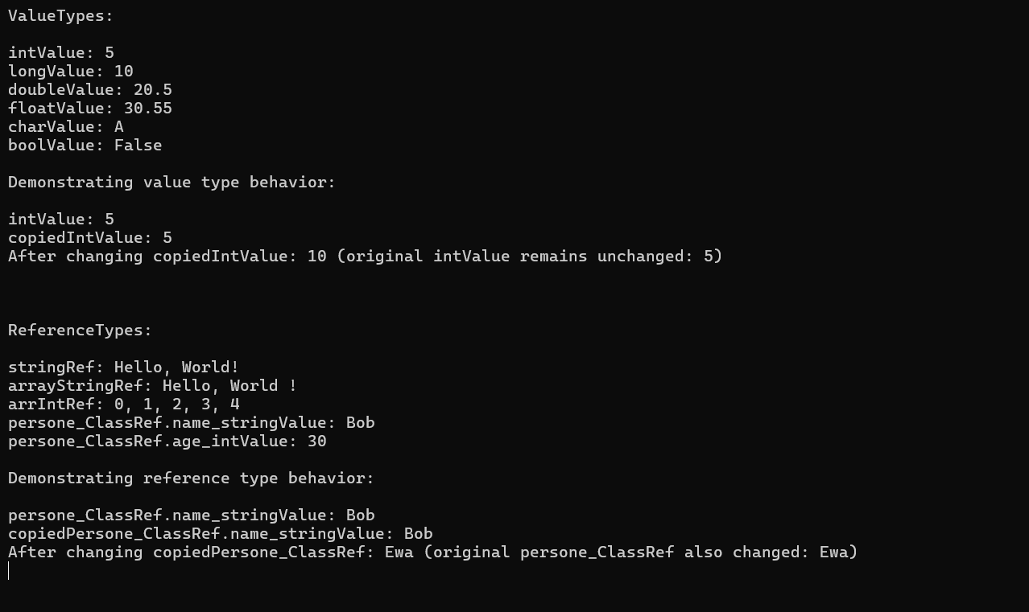
Console: Value types & Reference types

Slide 14
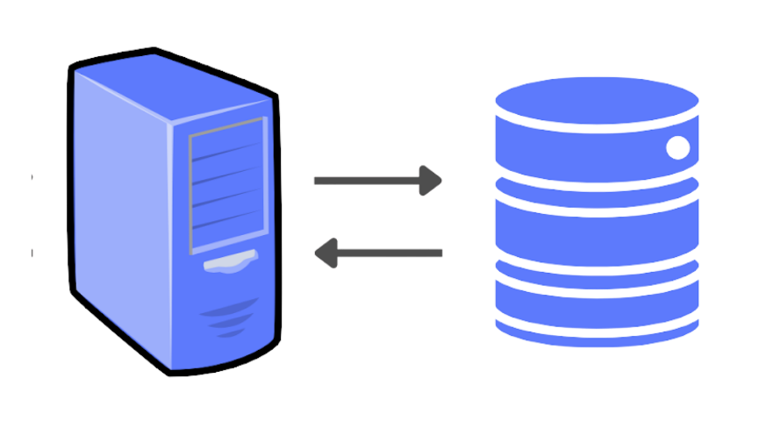
Backend
Backend
The server side of a website is everything the user doesn't see: the beating heart or engine that responds to requests, sending data to the frontend for display.
The backend consists of servers, databases, operating systems, APIs, and other components that work together to deliver the needed information to the user as quickly as possible.
Server
Database

Slide 15
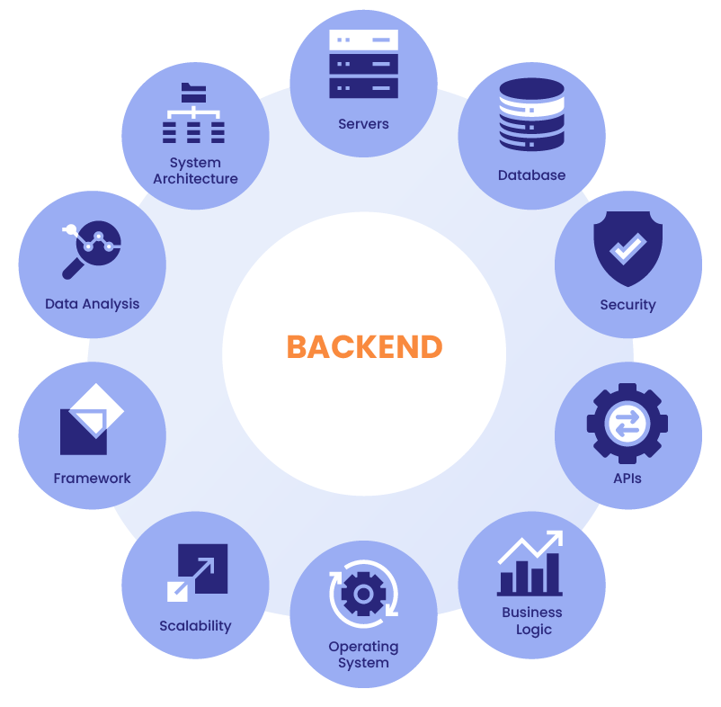
Why is the backend important for a website?
Request processing and business logi
Authentication and authorization
Data storage and management
Security
Flexible deployment

Slide 16

Database
A database is an organized collection of data stored in a computer system in electronic form. It allows you to quickly enter, edit, organize, and retrieve information.

Slide 17

ASP.NET
ASP.NET is a framework that is cross-platform and open-source.
The framework is designed for building web applications and services using .NET and C#. For example:
Creating endpoints using REST API and implementing functionality according to the given business logic, such as authentication, authorization, or data processing.

Slide 18
IDE
IDE (Integrated Development Environment) – This is the software needed for writing programs. An IDE typically includes the following tools:
Code editor
Compiler/Interpreter
Testing tools
Builder
Debugger
Package manager
In other words, it is a comprehensive environment that simplifies the development process, making it more efficient and convenient.

Slide 19
Visual Studio
Visual Studio is an integrated development environment created by Microsoft.
Visual Studio supports programming languages: C#, C++, JavaScript, TypeScript, Python, F#
Visual Studio allows you to use the following frameworks: .NET (Framework/Core), MSTest, xUnit

Slide 20
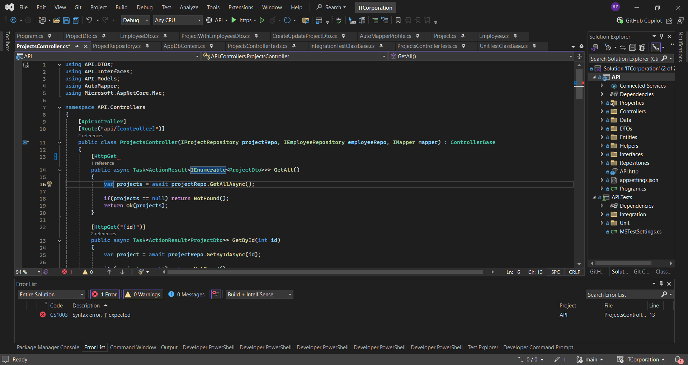
VS Graphical Interface
Start button
Solution Explorer
Code editor
Error list

Slide 21
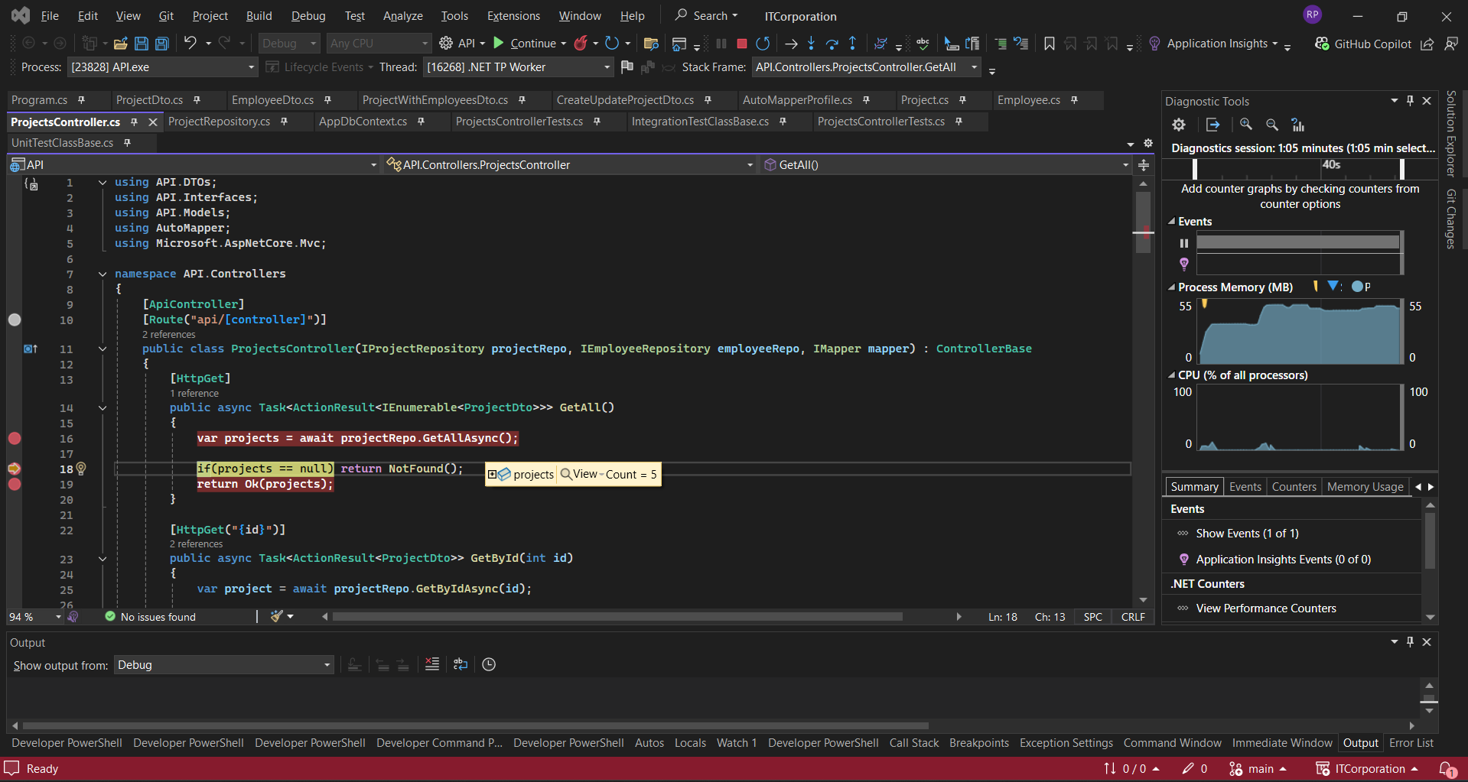
VS Graphical Interface
Debugger buttons
Breakpoint
Detailed information about the "project"

Slide 22
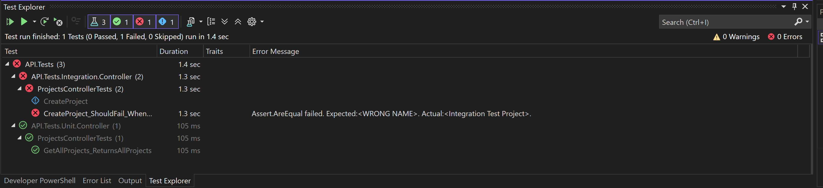
Tests — "Test Explorer"
In the Visual Studio code editor, there is a "Test Explorer" tab where you can run tests, see their statuses, and error messages if there are any.
Start buttons
Test statuses
Error list
Test list

Slide 23

Client-Server Architecture
Client-server architecture is one of the key software development patterns that dominates the creation of distributed network applications. It is based on the interaction and data exchange between the client and the server over a network.
It involves the following main components:
Client
Server
Network

Slide 24
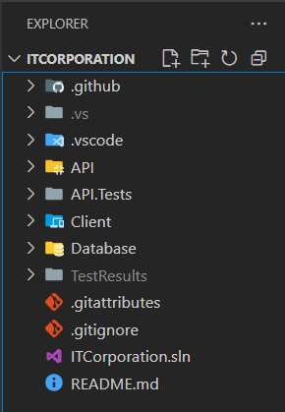
Client-Server Architecture
Client — initiates requests and displays results on the user's device (PC, phone, browser). (In our project, the client is built with Angular)
Server — processes requests, executes business logic, queries the database, and forms responses. Usually deployed in a data center or the cloud. (In our project, the server is written in ASP.NET Core, and data is stored in PostgreSQL)
Network — the communication channel (TCP/IP, HTTP/2, WebSocket, etc.) through which the client and server exchange messages.
(In our project, the interaction is organized through RESTful HTTP API)

Slide 25
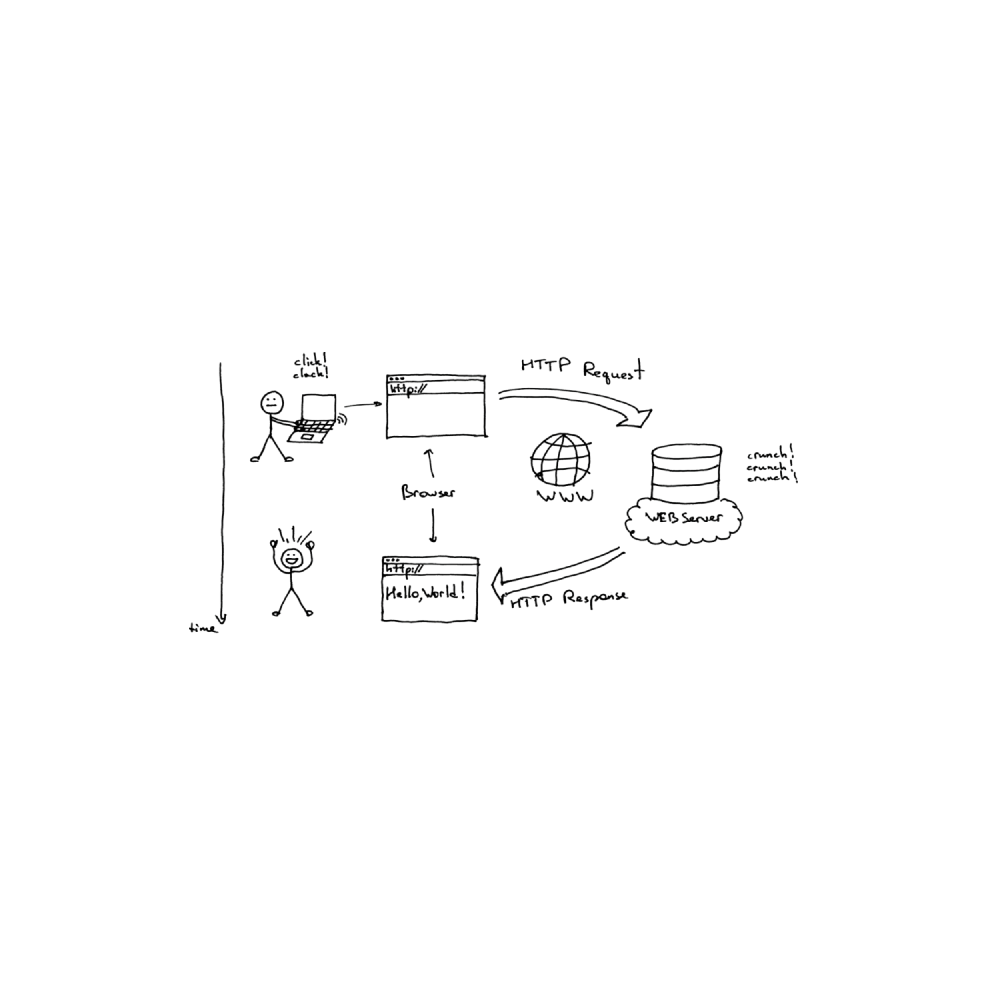
HTTP: How Request and Response Work
Client (frontend) sends an HTTP request to the server (optionally in JSON or XML format)
Server (backend) processes the request and forms an HTTP response, also (optionally in JSON or XML format)

Slide 26
Most Common HTTP Method Operations
Get – retrieves data
/users
/user/3
Returns status: 200 or 404
Put – updates a resource by Id
/user/3
Returns status: 200 or 404
Post – creates a new resource
/users
/user
Returns status: 201, 204 or 400
Delete – deletes a resource by Id
/user/3
Returns status: 204 or 404
List of HTTP methods https://en.wikipedia.org/wiki/HTTP#Request_methods

Slide 27
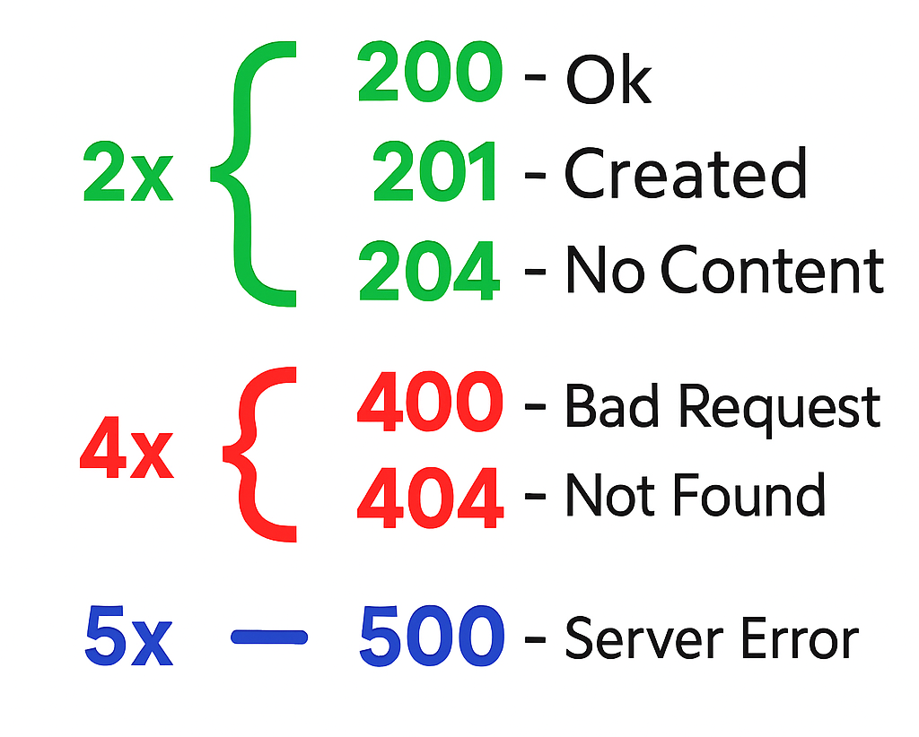
HTTP status codes:
List of HTTP status codes https://en.wikipedia.org/wiki/List_of_HTTP_status_codes

Slide 28

Swagger
Swagger is a tool for describing, documenting, and visualizing REST APIs.
Based on the Swagger specification, you can automatically generate source code for client libraries and clear text documentation.
Swagger creates documentation that is understandable to both humans and machines.
The tool also allows you to trigger endpoints to verify the functionality of our server.

Slide 29
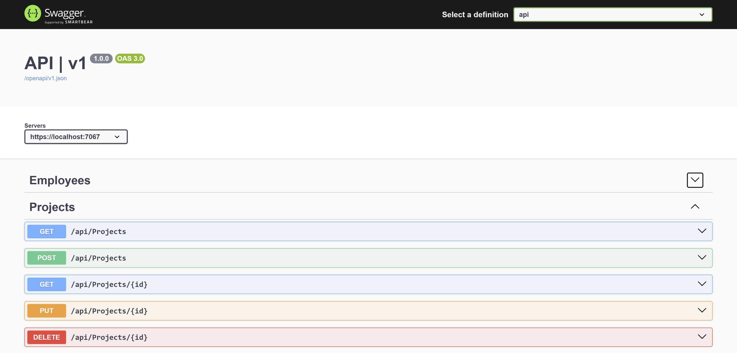
Swagger – List of Endpoints
Server localhost
List of endpoints

Slide 30
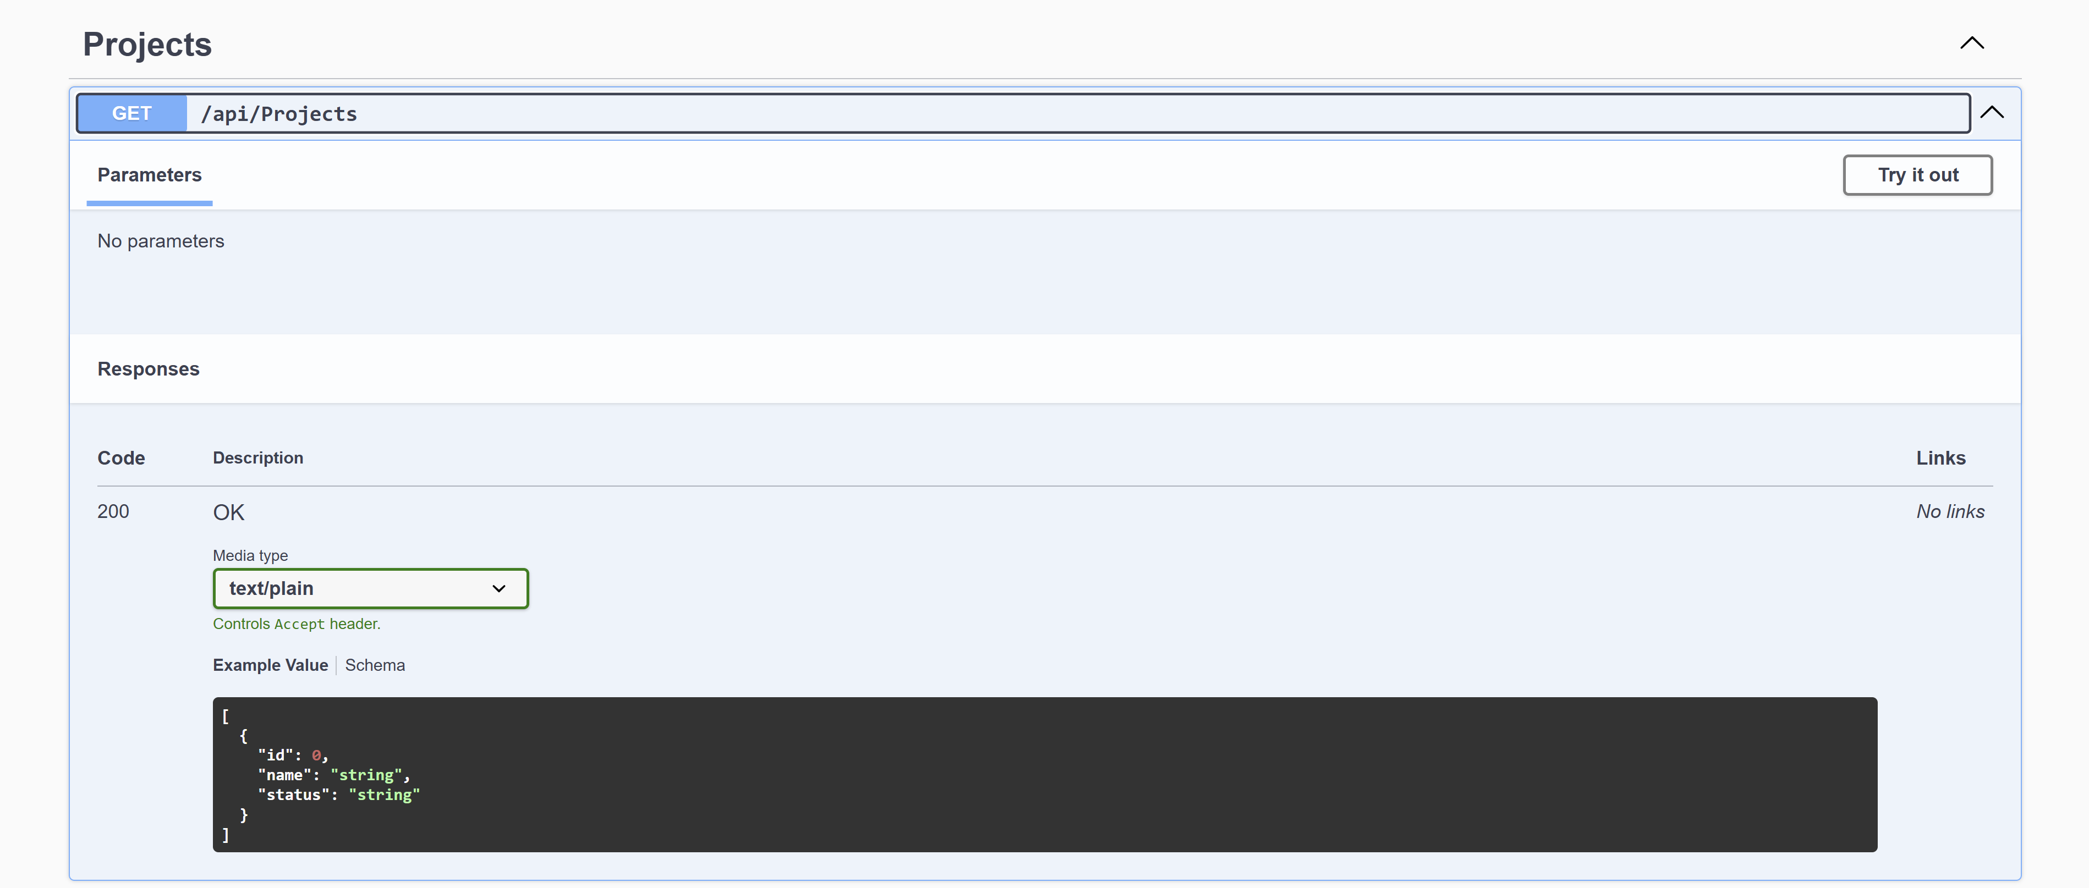
Swagger - Get All Projects
Endpoint
Parameters — which we can pass in the request, specifically in the header, path, and query parts
Response — body documentation about what we expect in the response in JSON format with status

Slide 31
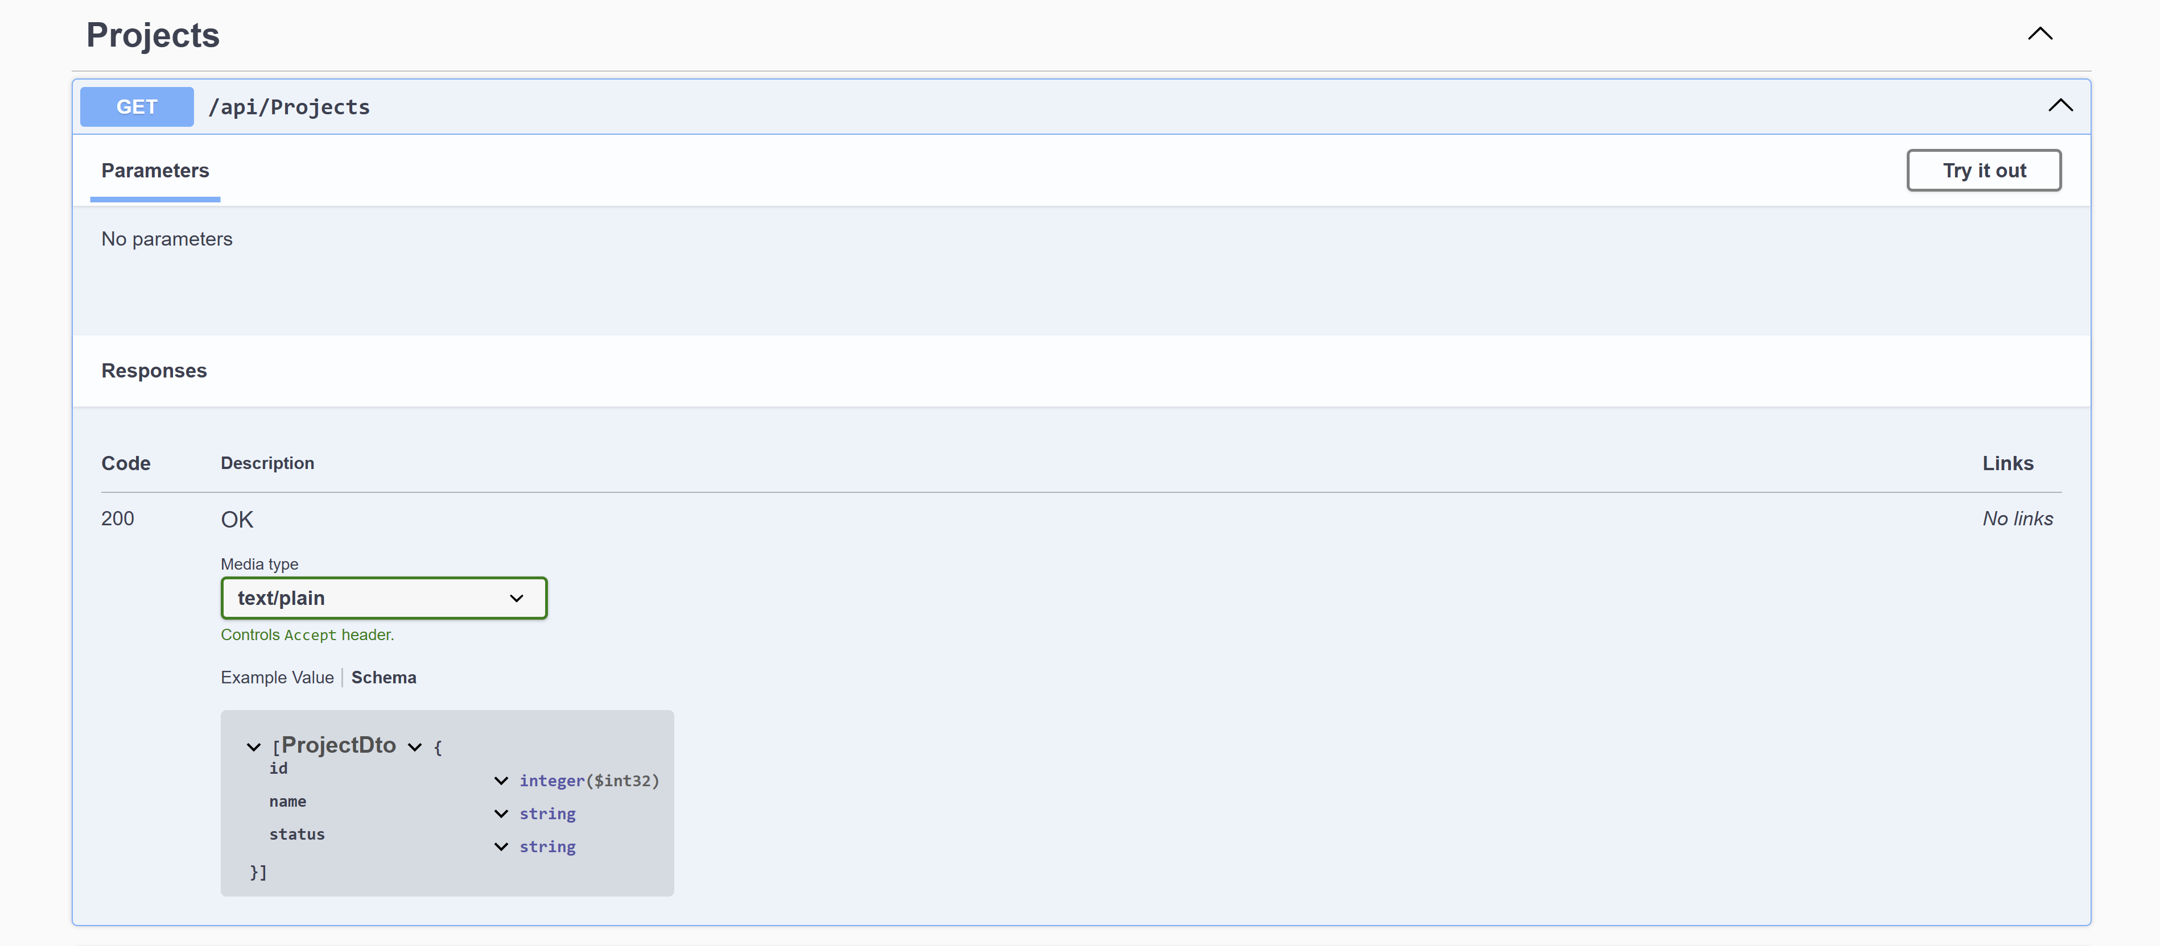
Swagger - Get All Projects
Response — documentation in the body section about what we expect in the response in the form of objects with status

Slide 32
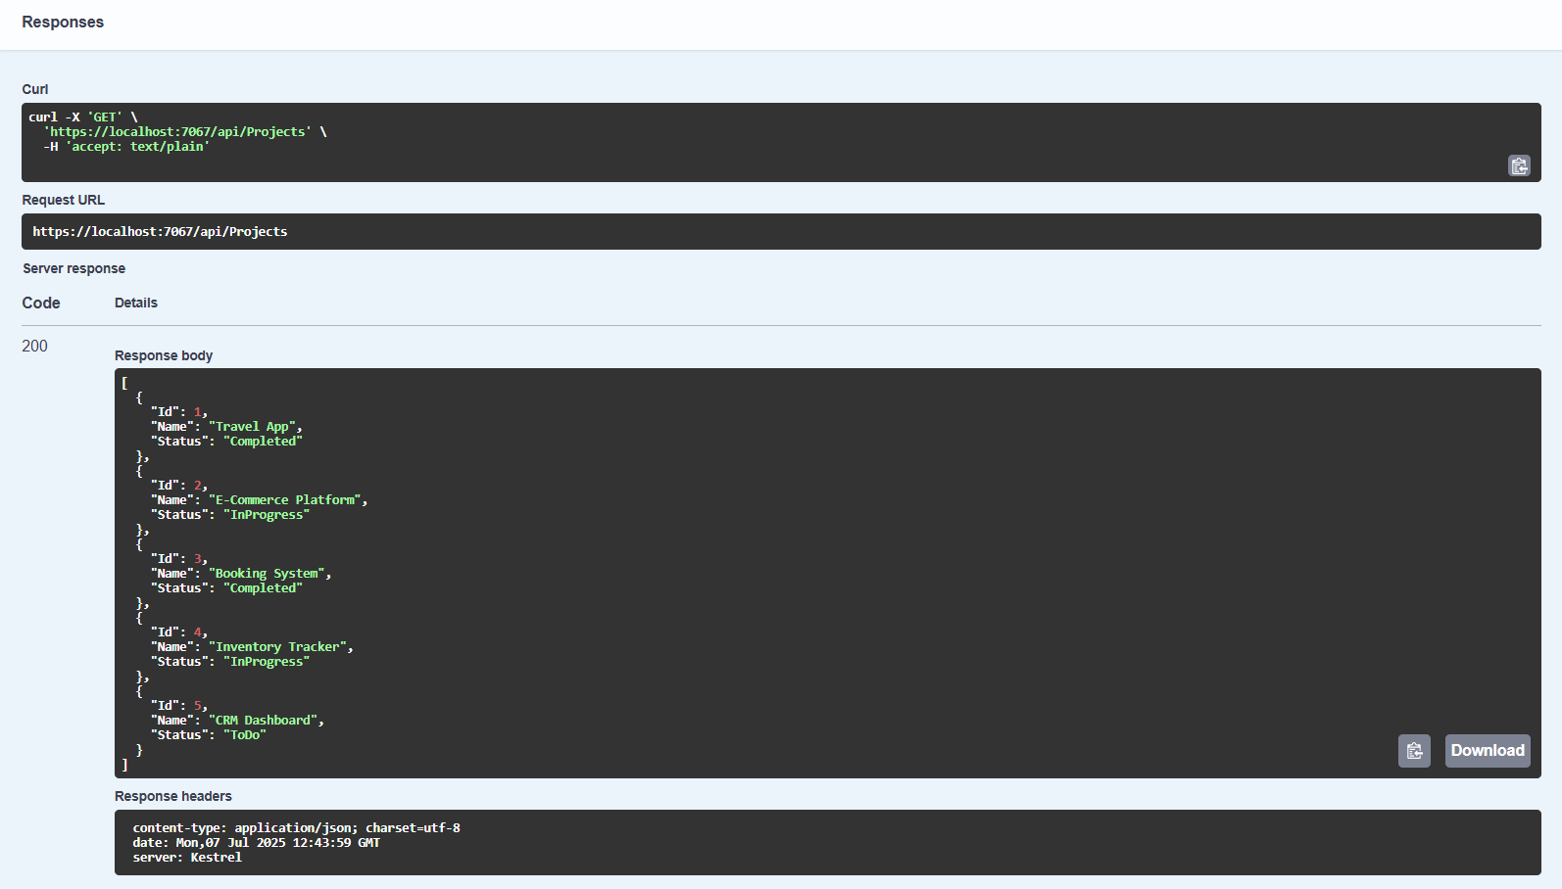
Swagger - Get All Projects
Запит на ендпоінт
Відповідь body з сервера – список проєктів в форматі JSON

Slide 33
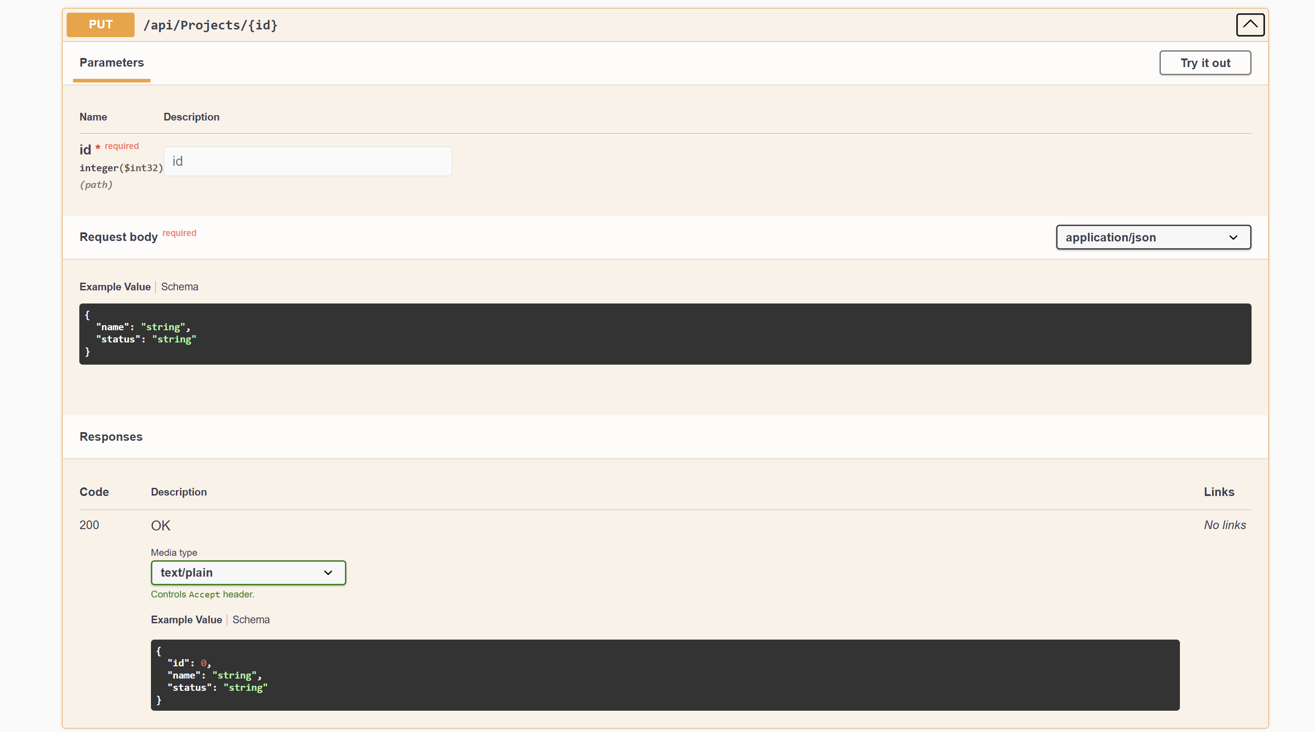
Swagger - Update Project
Parameters — which we can pass in the request, specifically in the header, path, and query parts
Request body — here we can specify what exactly we pass in our request in the body part in JSON format

Slide 34
Contents
Backend
Design: Class Diagram UML / ERD
Endpoint
Pattern DTO
ORM (EF) / Procedure
Middleware
Lifecycle of req/resp HTTP (Get, Post, Put, Delete)

Slide 35
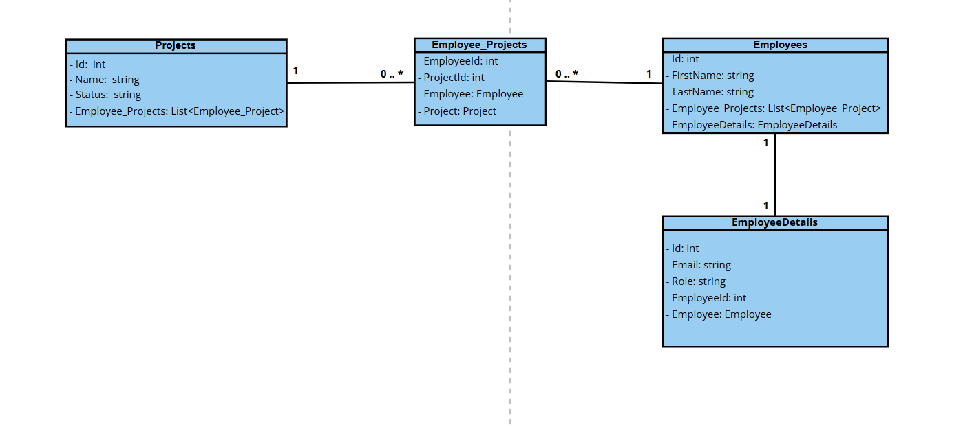
Design: Class Diagram in UML
Class Diagram (UML) is a static representation of the system's structure: it shows classes with their attributes and methods, and the relationships between them (associations, compositions, inheritance). It helps to quickly understand which entities exist in the domain and how they interact with each other.

Slide 36
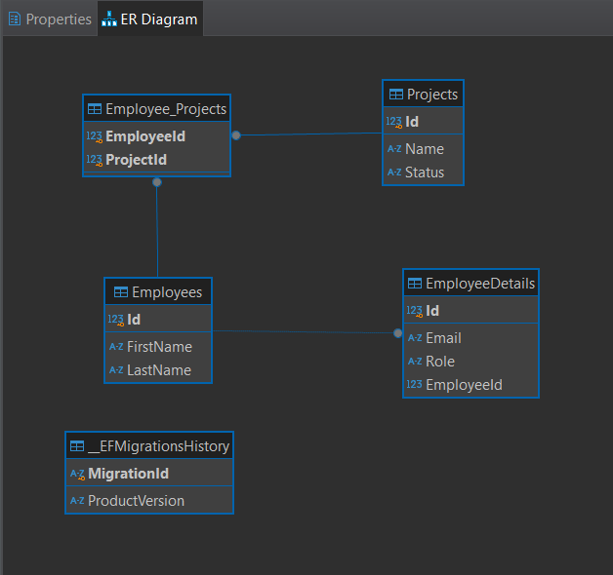
Design: Entity-Relationship Diagram
Entity-Relationship Diagram (ERD) is a graphical representation of the logical data model: it shows entity tables, their attributes, and relationships (1 : 1, 1 : N, M : N).
Allows you to quickly assess the database structure and verify data integrity.

Slide 37

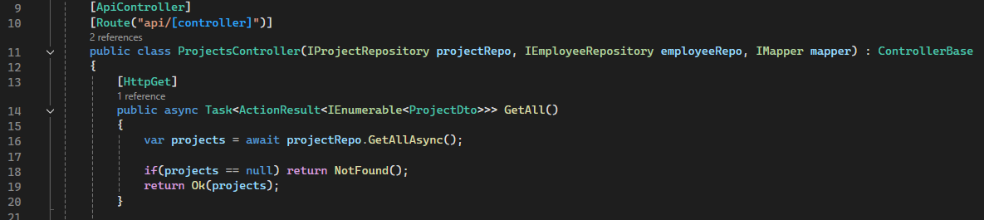
Endpoint
Example:
ndpoint — the interaction between two sides: the client and the server. In other words, it is a specific URL path where you can send requests and receive responses.

Slide 38
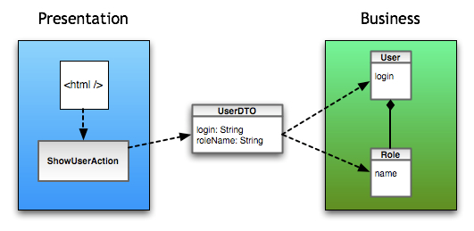
Project pattern DTO (Data Transfer Object)
DTO or (Data Transfer Object) is an object used for transferring data between domains (for example, in a client-server architecture).

Slide 39
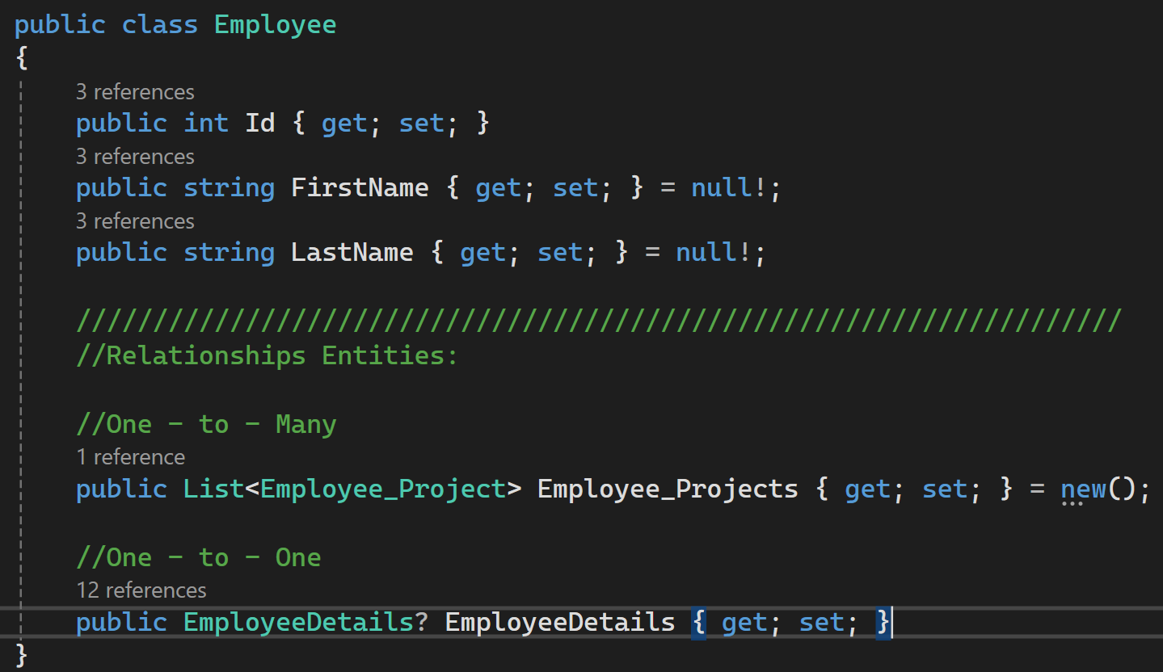
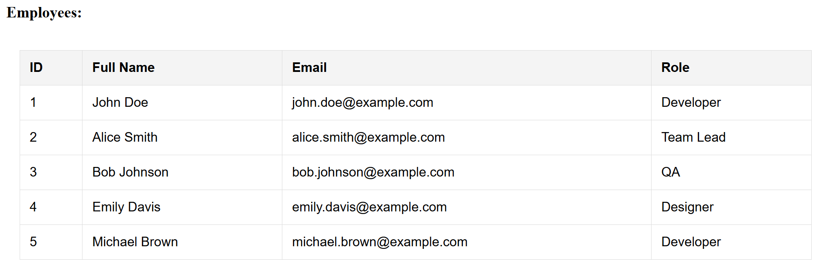
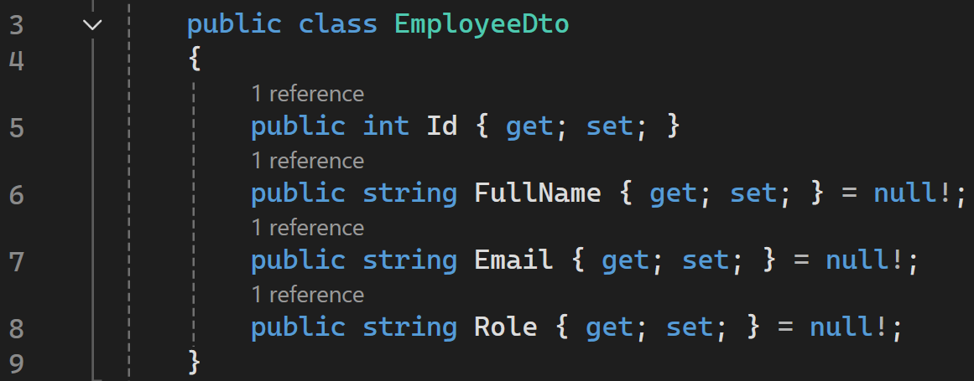
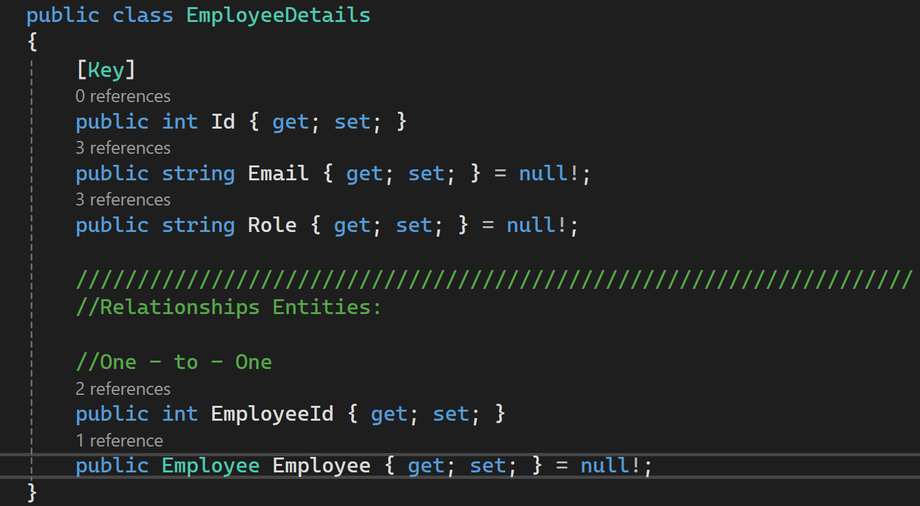
Приклад використання DTO
Backend
Frontend
DTO

Slide 40
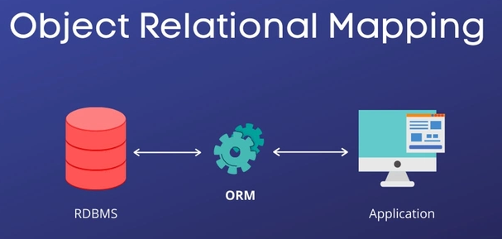
ORM (EF) / Procedure
ASP.NET Core also communicates with the database using Entity Framework technology, which is an example of the Object-Relational Mapper (ORM) programming type.
Communication with the database using:
Entity Framework
Procedure

Slide 41

Entity Framework
Entity Framework (EF) is a tool that simplifies the work of .NET applications with databases.
EF:
converts tables into objects so they are easier to work with in C#
allows you to write LINQ queries instead of SQL
automatically tracks changes and updates stored data
helps safely modify the database structure (migrations).
In summary, EF makes access to any supported database clear and simple.

Slide 42
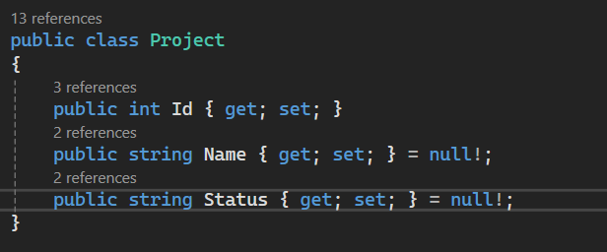
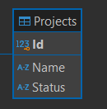
ORM
Object-Relational Mapper (ORM) — frees the developer from writing SQL queries and helps map our classes to tables in the database.
Mapping :
Class -> Table
Property -> Record
Class
Property
Table
Record

Slide 43
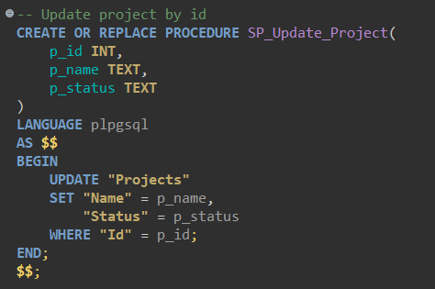
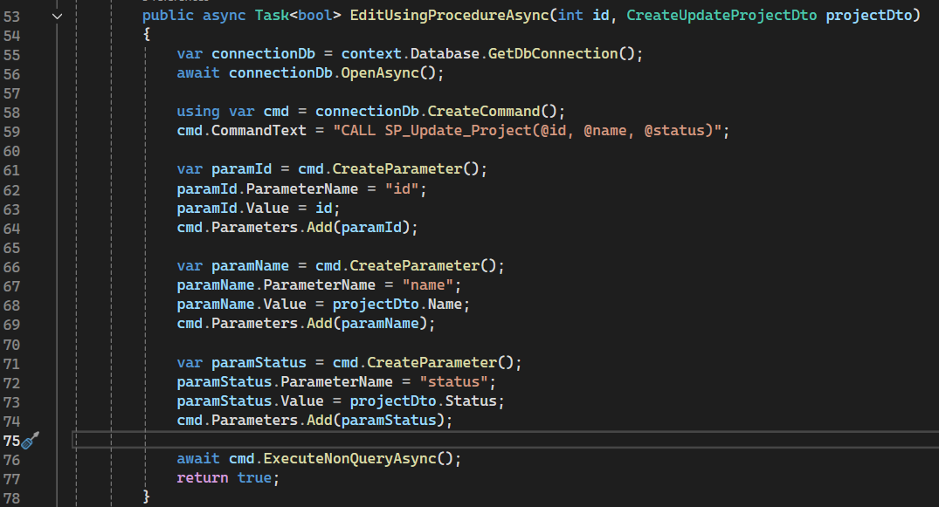
Procedure
Stored procedure — is a pre-created SQL script that is stored inside the database itself. The program simply "calls" this procedure by name and passes the required parameters.

Slide 44
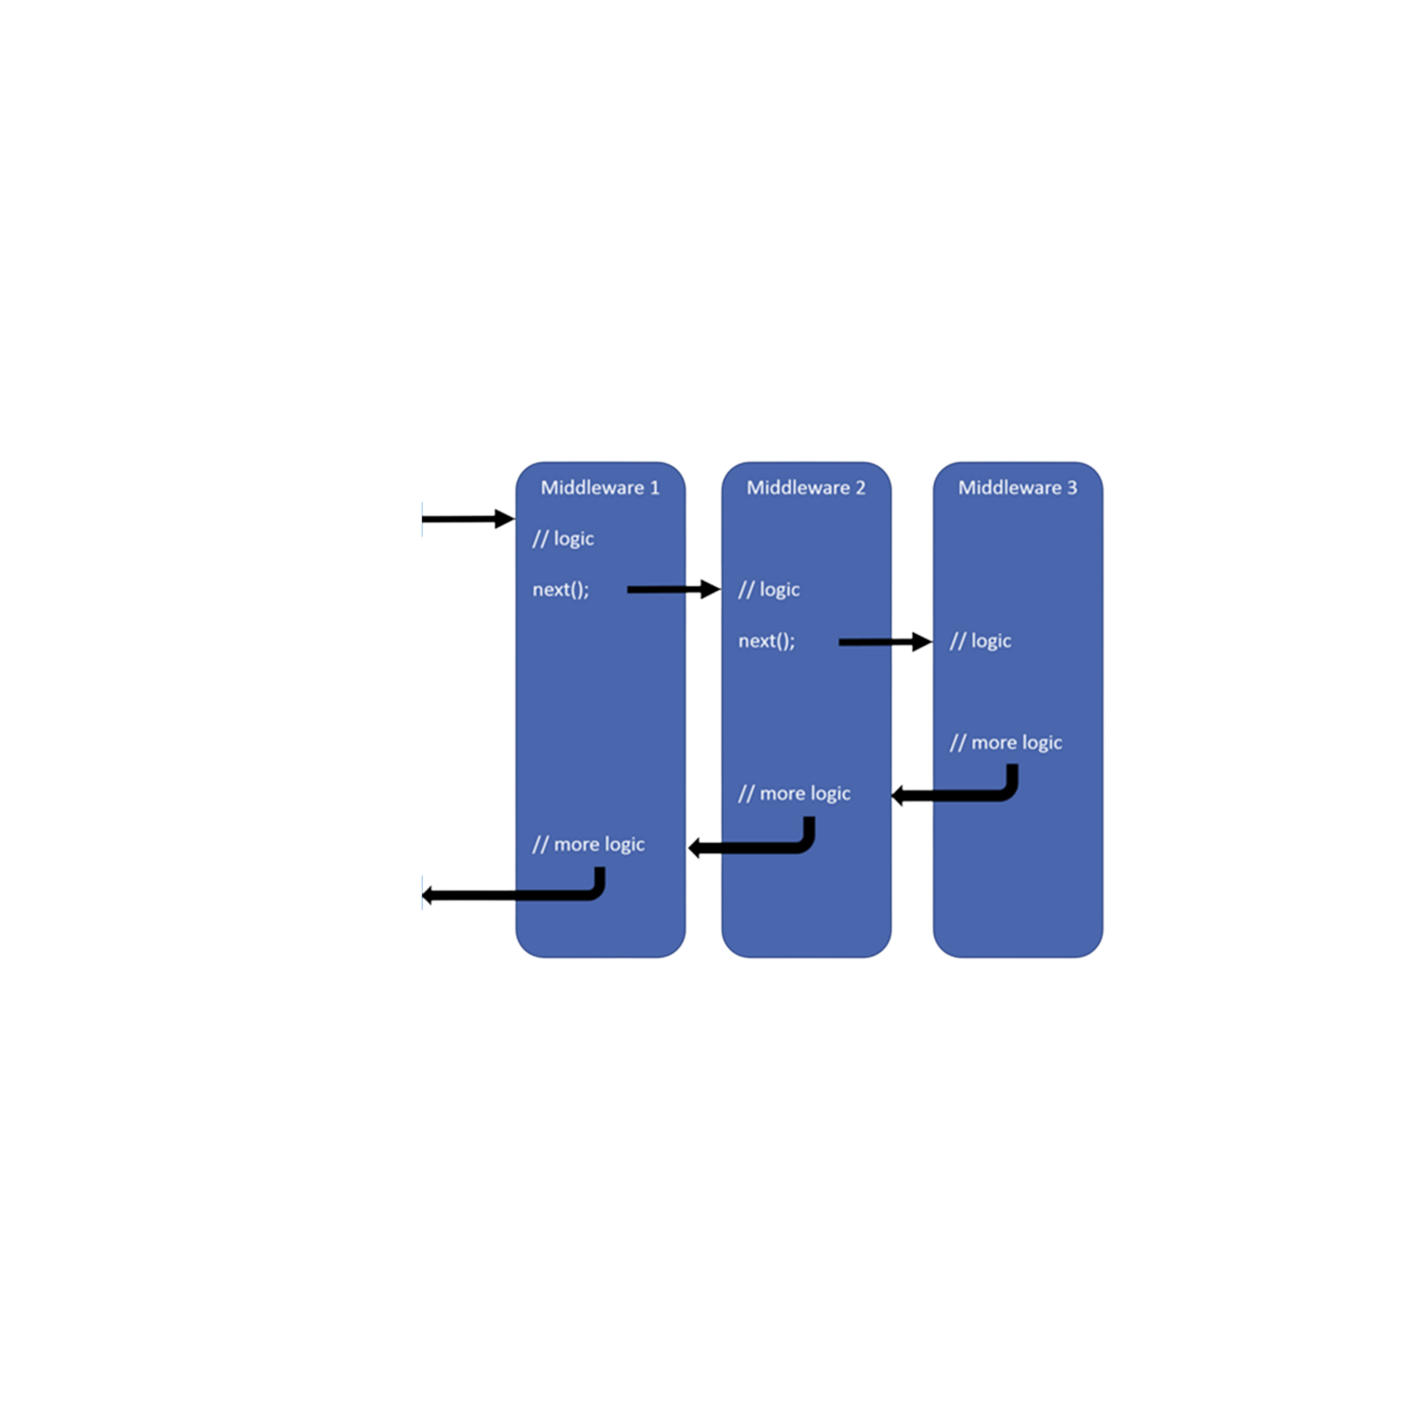
Middleware
Middleware is a central element of request and response processing in a web application.
In ASP.NET, middleware is configured in the Program.cs file (starting from .NET 6)
Request
Response

Slide 45
Middleware
Middleware formation happens only once — during server startup. (This is done by the .Build() method in Program.cs)
The middleware pipeline execution happens every time an HTTP request arrives from the client. (This is executed by the .InvokeAsync() method)
So the pipeline is built once, but is traversed (executed) on every request.

Slide 46
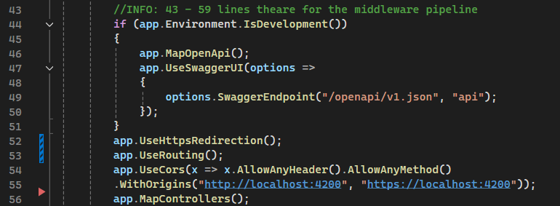
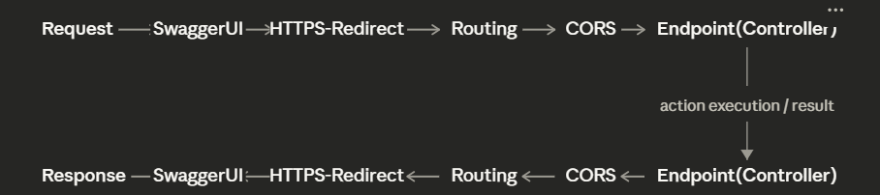
Middleware Pipeline

Slide 47

Req/Resp HTTP lifecycle – GET All
HTTP request, type GET
https://localhost:7067/api/projects
Middleware( Routing )
ProjectsController( GetAll )
Repository( GetAllAsync )
9. HTTP response (Ok + JSON)
8. Serialization DTO -> JSON
7. ProjectsController( GetAll )
6. Repository( GetAllAsync )
Maps Entity -> DTO
5. AppDbContext

Slide 48
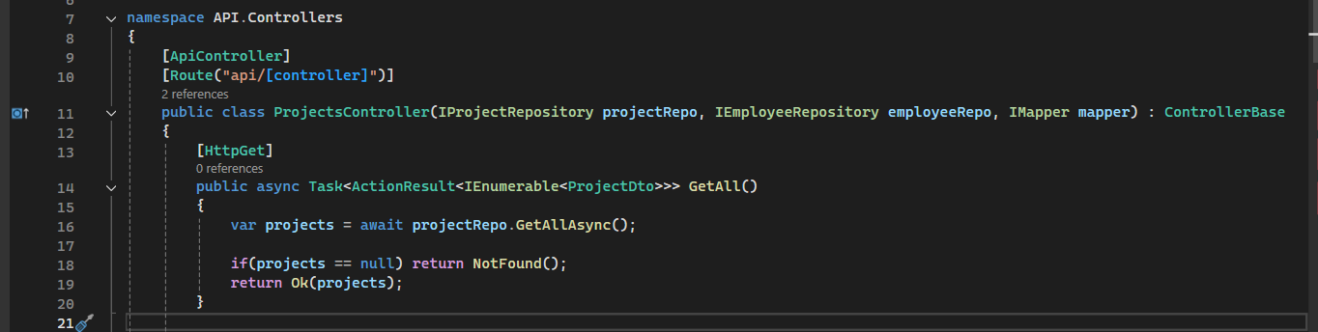
Code: Endpoint Get All

Slide 49

Req/Resp HTTP lifecycle - Get by ID with employees
HTTP request, type GET (by Id)
https://localhost:7067/api/projects/1/with-employees
Middleware( Routing )
ProjectsController( GetWithEmployees )
Repository( GetWithEmployeesAsync )
9. HTTP response (Ok + JSON)
8. Serialization DTO -> JSON
7. ProjectsController( GetWithEmployees )
6. Repository( GetWithEmployeesAsync )
Maps Entity -> DTO
5. AppDbContext

Slide 50
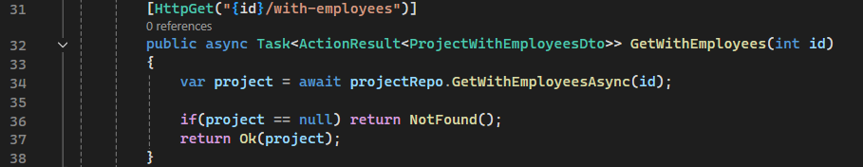
Code: Endpoint Get by Id

Slide 51

Req/Resp HTTP lifecycle - POST
HTTP request, type POST
https://localhost:7067/api/projects
Middleware( Routing )
Deserialization JSON -> DTO
ProjectsController( Create )
Maps DTO -> Entity
Repository(AddAsync)
10. HTTP response(Created + JSON)
9. Serialization DTO -> JSON
8. ProjectsController( Create )
Maps Entity -> DTO
7. Repository( SaveChangesAsync )
6. AppDbContext

Slide 52
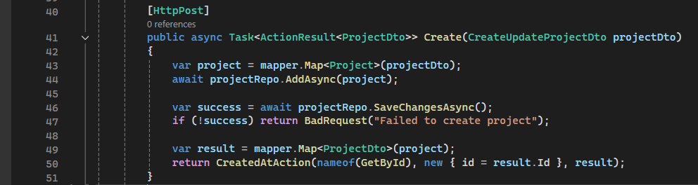
Code: Endpoint Post

Slide 53

Req/Resp HTTP lifecycle– PUT
HTTP request, type PUT
https://localhost:7067/api/projects/6
Middleware( Routing )
Deserialization JSON -> DTO
ProjectsController( Update )
Repository( GetEntityByIdAsync, EditUsingProcedureAsync, GetByIdAsync)
Maps Entity -> DTO
9. HTTP response (Ok + JSON)
8. Serialization DTO -> JSON
7. ProjectsController( Update )
6. AppDbContext

Slide 54
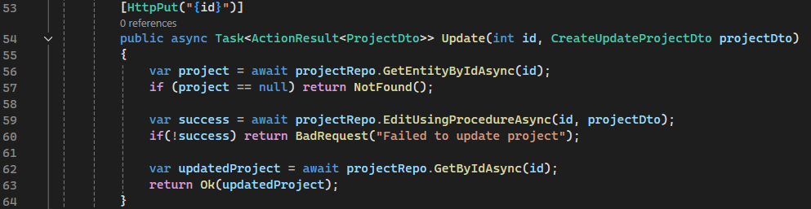
Code: Endpoint Put

Slide 55

Req/Resp HTTP lifecycle - DELETE
HTTP request, type DELETE
https://localhost:7067/api/projects/6
Middleware( Routing )
ProjectsController( Delete )
Repository( GetEntityByIdAsync, Delete, SaveChangesAsync )
7. HTTP response ( NoContent )
6. ProjectsController( Delete )
5. AppDbContext

Slide 56
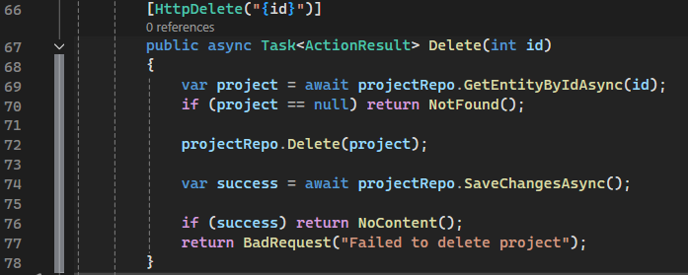
Code: Endpoint Delete

Slide 57
Contents
Backend
Req/resp HTTP lifecycle with status 400 and 404
Unit Tests vs Integration Tests
Pattern: AAA
Unit Tests
Integration Tests
Database
SQL & NoSQL
INSERT INTO

Slide 58
Error - 404 Not found
HTTP request, type PUT
https://localhost:7067/api/projects/simulate-not-found-project/6
Middleware( Routing )
Deserialization JSON -> DTO
ProjectsController( Update )
Repository( GetEntityByIdAsync )
8. HTTP response ( NotFound )
ProjectsController( Update )
NotFound()
6. AppDbContext

Slide 59
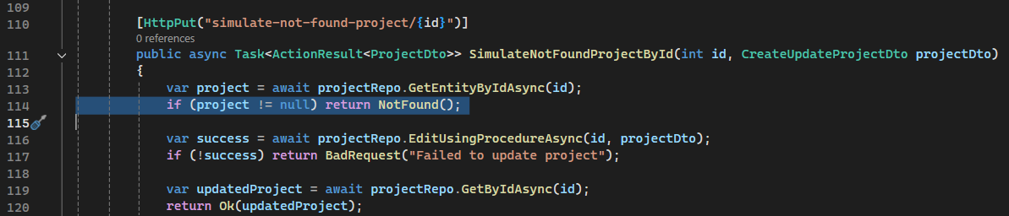
Code: Error - 404 Not found

Slide 60
Error – 400 Bad request
HTTP request, type POST
https://localhost:7067/api/projects/simulate-bad-request-create-project
Middleware( Routing )
Deserialization JSON -> DTO
ProjectsController( Create )
Maps DTO -> Entity
Repository(AddAsync)
9. HTTP response ( BadRequest )
8. ProjectsController( Create )
BadRequest()
7. Repository( SaveChangesAsync )
6. AppDbContext

Slide 61
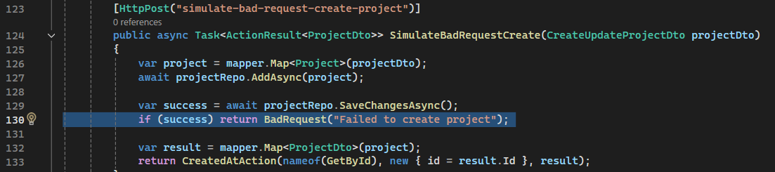
Code: Error – 400 Bad request

Slide 62


Unit Tests vs Integration Tests
 | Unit test | Integration test
Definition | Test individual functions, methods, or classes in isolation, without dependencies on other parts of the system. | Test the interaction between different components of the system to ensure they work correctly together.
Libraries | xUnit MSTest | xUnit MSTest

Slide 63
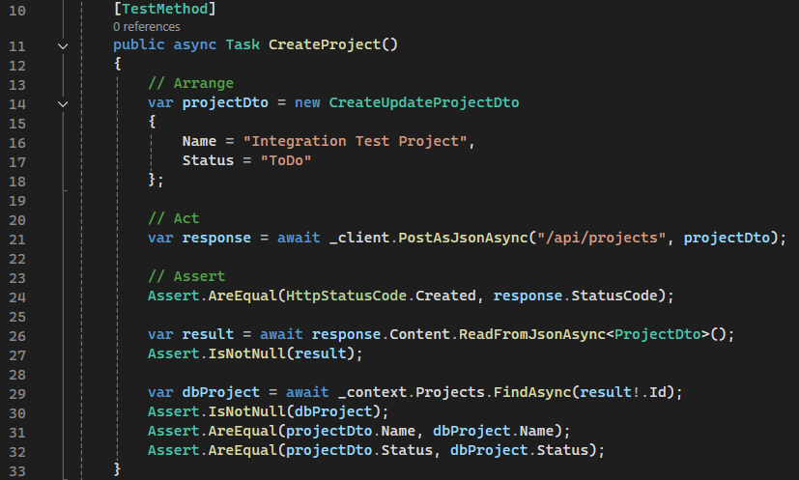
Testing and the Arrange, Act and Assert (AAA) Pattern
The AAA testing pattern is an approach that involves dividing a test method into three parts:
Arrange (setup),
Act (execution of the action),
Assert (verification of the result)

Slide 64
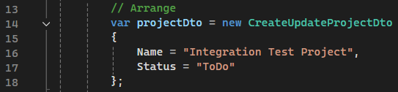
Arrange
Arrange – this stage prepares everything needed to execute the test, to ensure it produces accurate results. This includes initializing objects, setting up dependencies, and the environment required for the test scenario.

Slide 65
Act
Act – this is the stage where you execute the specific functionality you want to test. It involves interacting with the SUT (System Under Test — the system being tested) by calling a method or executing a function that you prepared in the previous stage.

Slide 66
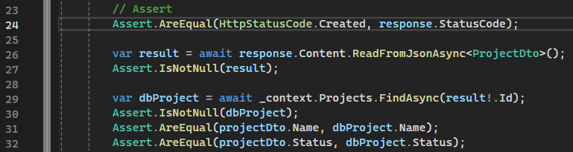
Assert
Assert – at this stage, a verification is performed to check whether the result of the unit test matches your expectations. It involves checking the results obtained at the Act stage against expected values, to confirm that the SUT (System Under Test) works properly.
List of Assert methods - https://learn.microsoft.com/en-us/dotnet/api/microsoft.visualstudio.testtools.unittesting.assert?view=mstest-net-3.9

Slide 67
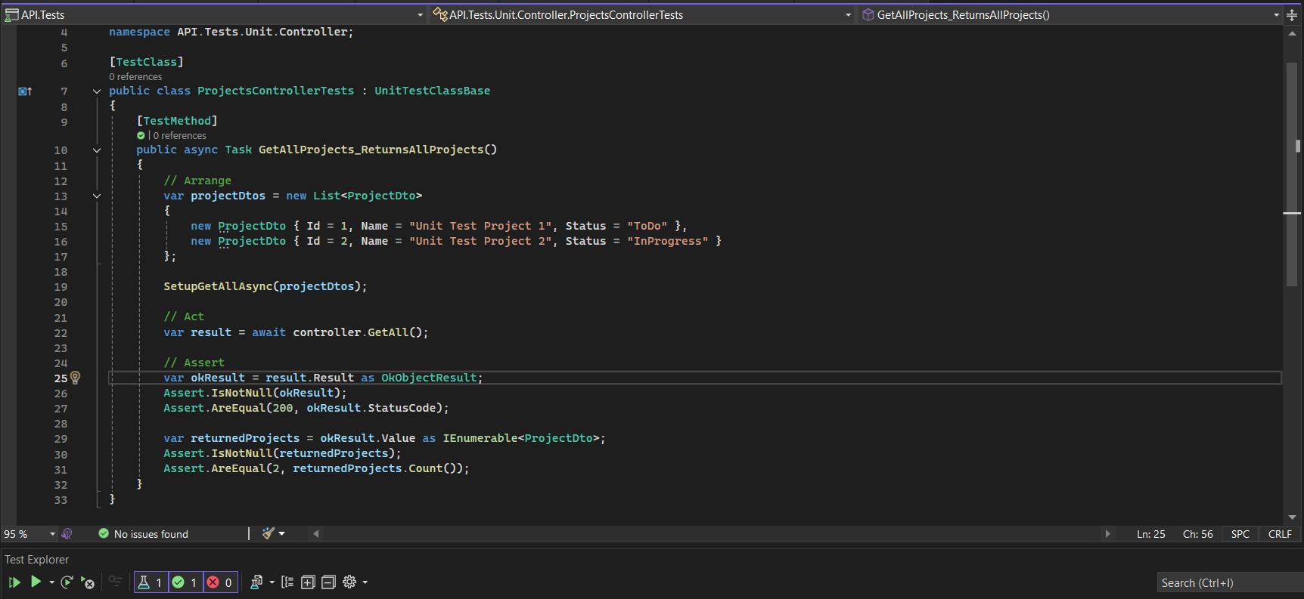
Code: Unit test

Slide 68
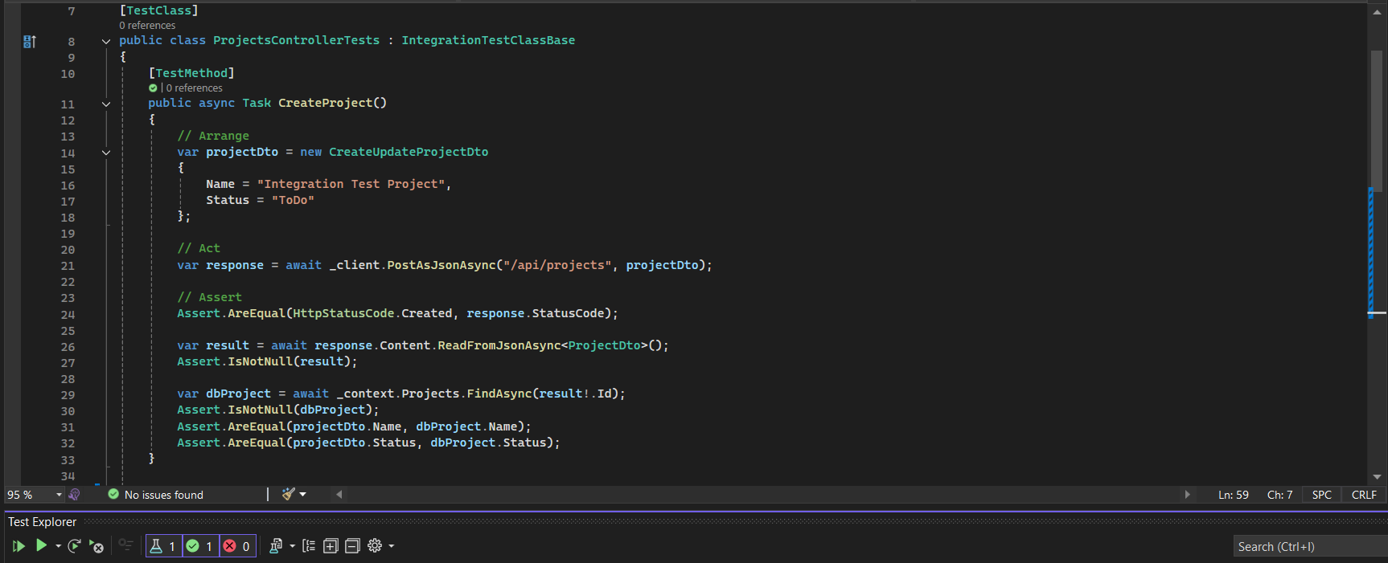
Code: Integration test

Slide 69
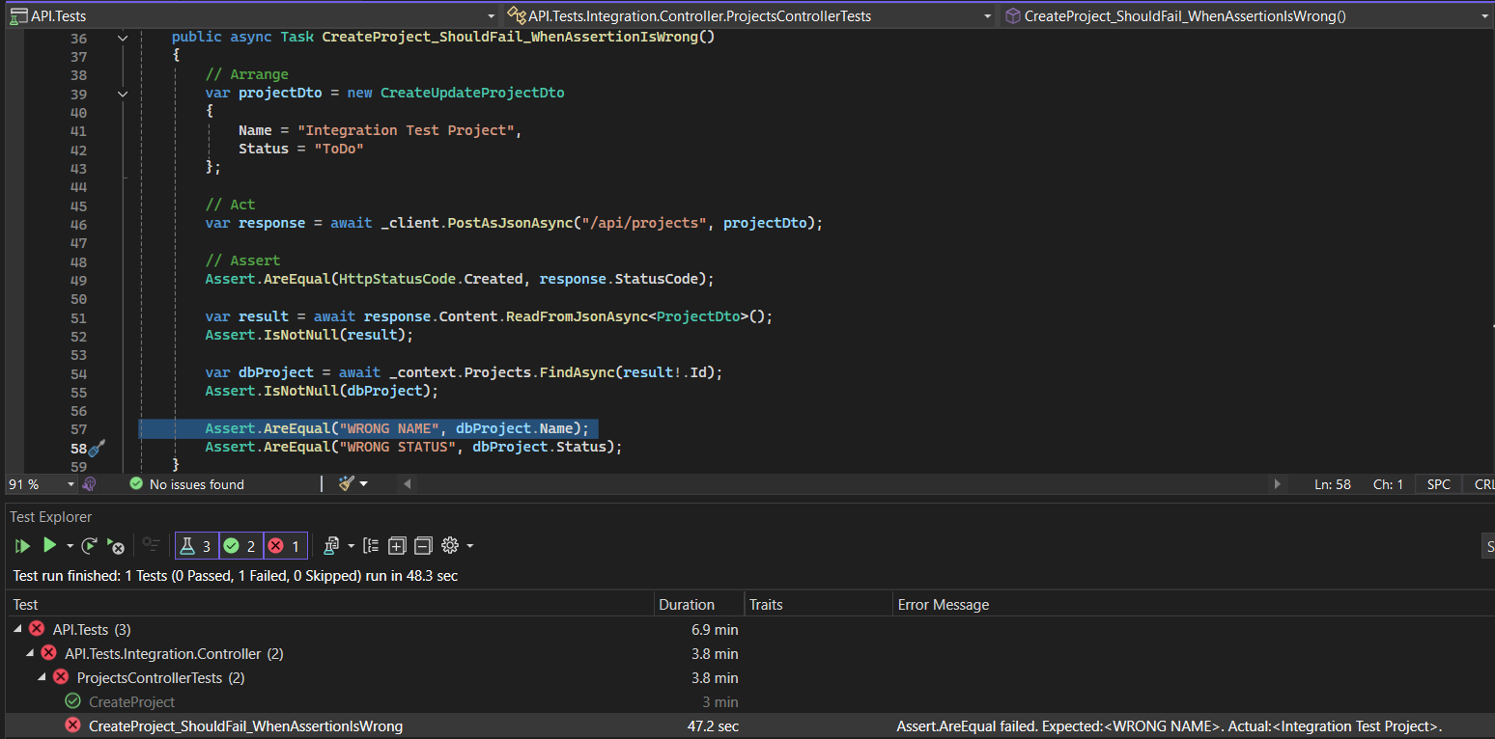
Code: Integration test

Slide 70
Database

Slide 71
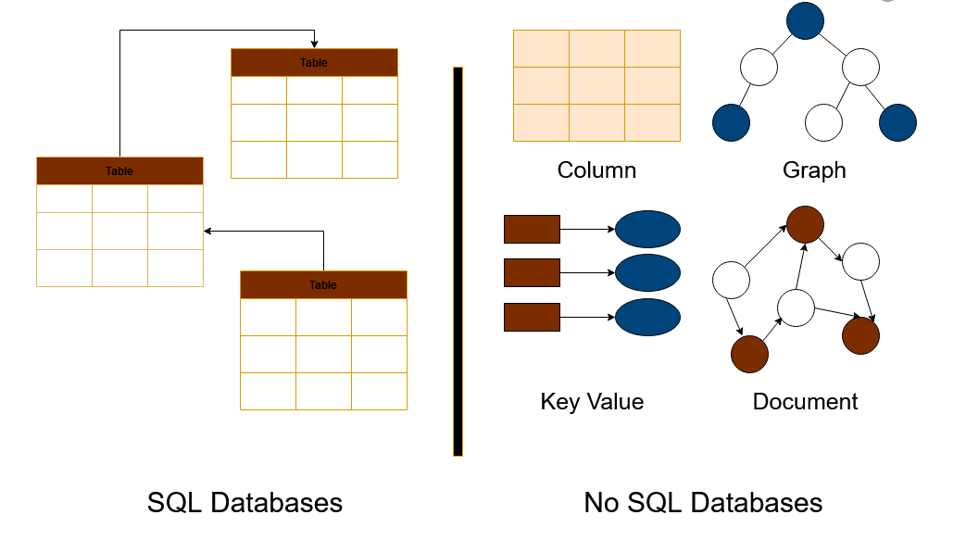
SQL & NoSQL
SQL and NoSQL are two different database technologies.
SQL databases emphasize structured relational models.
NoSQL databases use a flexible, schema-less approach to handle diverse and dynamic data, with a focus on scalability and speed.

Slide 72
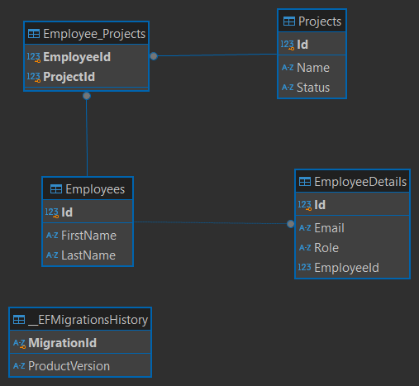

SQL Database Characteristics
Schema: describes the database structure — tables, fields, data types, allowed values, and relationships between tables.
Tables: the main elements of the database that represent entities (for example, clients or transactions). Rows contain individual records, and columns contain attributes (for example, name, email).

Slide 73
Breakdown of a Table Structure in SQL
A traditional database is organized in the form of tables, where:
Inside the table there are rows and columns
Rows are records or tuples (for example, one project)
Columns are fields or attributes (for example, name or status of a project)
Тable
Field, Column, Attribute
Record, Row, Tuple

Slide 74



Popular SQL Database Systems
PostgreSQL
Microsoft SQL Server (MSSQL)
MySQL
Oracle
SQLite

Slide 75


NoSQL Database Characteristics
Dynamic schema: Unlike the predefined, fixed schemas of relational databases, non-relational databases provide flexibility. Different records in the same database can have different fields. For example, in a customer database, one client may have a name and age field, while another may have a name and email field.

Slide 76



Popular NoSQL Database Systems
MongoDb
Neo4J
Cassandra
Redis

Slide 77
Relational Database Management System
Relational database management system — relational database management system (RDBMS) is a set of programs that allow you to store, edit, organize, and search data in relational databases.
For example:
PostgreSQL,
Microsoft SQL Server

Slide 78

Database Server
Virtual Database Server
Database server (Database Server) — is a server (physical or virtual) that stores databases and provides access to them.
Each database server contains a database management system — software for storing, searching, updating, and deleting data.
Database

Slide 79

SQL and Its Syntax
SQL – Structured Query Language) is a special language used for creating, editing, and retrieving data from databases.

Slide 80

INSERT INTO
Populates an existing table with data (seed table)
SQL query template:
INSERT INTO “Table_name”(“Field_1”, “Field_2”) VALUES
(“ABC”, 123),
(“xyz”, 098);

Slide 81
Contents
Database
SELECT
WHERE
ORDER BY
GROUP BY
JOINs
PROCEURE
CTE
Normalization(NF1-3)/Denormalization

Slide 82
Logical and Physical Execution of SQL Statements
The user writes a query according to the syntax in this order (logical):
However, SQL interprets it in a different order (physical):
SELECT
FROM / JOIN
WHERE
GROUP BY
HAVING
ORDER BY
LIMIT
FROM / JOIN
WHERE
GROUP BY
HAVING
SELECT
ORDER BY
LIMIT

Slide 83

1. SELECT
Outputs the full table with all fields and records
SQL query template:
SELECT *
FROM “Table_name”

Slide 84


1.1. SELECT
Outputs only specific columns of the table, not the entire table
SQL query template:
SELECT “Column_name”
FROM “Table_name”
SELECT
“Column_name_A”,
“Column_name_B”
FROM “Table_name”

Slide 85


2. WHERE
Filters table data by a given condition. We can also use conditional operators (BETWEEN, AND, OR).
SQL query template:
SELECT * FROM "Table_name"
WHERE "Table_name"."Column_name" = 'value’
SELECT
t.“Column_name_A”,
t.“Column_name_B”
FROM “Table_name” AS t
WHERE t."Column_name" = ‘value’

Slide 86


3. ORDER BY
Sorts records in a table by the specified column in order:
ASC – ascending (from A to Z or from 0 to 9)
DESC – descending (from Z to A or from 9 to 0)
SQL query template:
SELECT * FROM "Table_name"
ORDER BY "Table_name"."Column_name" ASC
SELECT * FROM "Table_name"
ORDER BY "Table_name"."Column_name" DESC

Slide 87

4. GROUP BY
Groups records by the specified column and allows applying aggregate functions (COUNT, SUM, AVG, MAX, MIN, etc.).
SQL query template:
SELECT
"Column_name",
COUNT(*) AS " Num_order "
FROM "Table_name"
GROUP BY "Table_name"."Column_name"

Slide 88

Joining tables
JOIN – combines data from two tables.
JOIN typically combines rows with matching values in the specified columns. Usually, one table contains a primary key, which is a column that uniquely identifies rows in the table. The other table has a column or columns that reference the primary key in the first table. These columns are foreign keys. The JOIN condition is the equality between the primary key columns in one table and the columns that reference them in the other table.
Table: Employee
Table: EmployeeDetails

Slide 89
5. LEFT JOIN
Joins two tables, returning all records from the left table with matching rows from the right table. Rows without a match are filled with NULL.
SQL query template:
SELECT * FROM "Table_name_A" tA
LEFT JOIN “Table_name_B” tBON tA.”Id_tA” = tB.”Id_tB”

Slide 90

5.1. RIGHT JOIN
Joins two tables, returning all records from the right table with matching rows from the left table. Rows without a match are filled with NULL.
SQL query template:
SELECT * FROM "Table_name_A" tA
RIGHT JOIN “Table_name_B” tB ON tA.”Id_tA” = tB.”Id_tB”

Slide 91

5.2. FULL JOIN
Joins two tables, returning all records from both the left and right tables. Rows without a match are filled with NULL.
SQL query template:
SELECT * FROM "Table_name_A" tA
FULL JOIN “Table_name_B” tB ON tA.”Id_tA” = tB.”Id_tB”

Slide 92
6. STORED PROCEDURE (PROCEDURE)
A procedure is an SQL instruction stored in the database. Its main purpose is to accept parameters and execute logic according to the developer's intent. If you frequently run the same query, a procedure helps save time by avoiding code repetition. Procedures can be called multiple times, are stored on the server, and run faster than regular queries. They are used for: updating data, checking conditions, processing transactions, etc.

Slide 93

6.1 STORED PROCEDURES (PROCEDURE)
CREATE PROCEDURE [proc_name]
(
[param1] [datatype],
[param2] [datatype]
)
LANGUAGE plpgsql
AS $$
BEGIN
-- logic here
END;
$$
DROP PROCEDURE [proc_name]([datatype], [datatype], [datatype]);
CALL [proc_name] ( [Id], [param2], [param2]);

Slide 94
7. (CTE) Common Table Expression
CTE – A temporary result (virtual table) that can be used within a single query.
It exists only during the execution of that single query.
Useful for improving the readability of complex queries.

Slide 95

7.1. (CTE) Common Table Expression
WITH [CTE_NAME] AS
(
SELECT …
)
SELECT * FROM [CTE_NAME];

Slide 96
Normalization
Brings order to the database.
Normalization has several key steps called Normal Forms, which follow a sequence (NF1, NF2, NF3).
Each subsequent normal form requires stricter conditions, progressing from the least strict to the most strict level of database normalization.

Slide 97

Why is database normalization needed?
Reduces the load on the server
Reduces the amount of memory the database occupies
Increases the execution speed of SQL queries

Slide 98
NF1
All attributes are simple (no data concatenation or combining)
No repeating attributes (all attributes are non-repeating and non-interchangeable)
Each cell of the relation contains only a single value
Id | Name | Surname | PC_Id
1 | Ivan | Korba | 1
2 | Alex | Katchenko | 2
3 | Sofi | Chirva | 3
Id | Name | Name | PC_Id
1 | Ivan123 | Ivan123 | 1
2 | Alex, Vitaliy | Alex, Vitaliy | 2
3 | Sofi | Sofi | 3

Slide 99
NF2
NF2 also has the same rules as NF1
No partial dependency. That is, all non-key attributes fully depend on the primary key
Id | Name | Surname | PC_Id
1 | Ivan | Korba | 1
2 | Alex | Katchenko | 2
3 | Sofi | Chirva | 3
Id | Name | Surname | PC_Id | OS
1 | Ivan | Korba | 1 | Windows
2 | Alex | Katchenko | 2 | macOS
3 | Sofi | Chirva | 3 | Linux
3 | Sofi | Chirva | 4 | macOS
PC_Id | OS
1 | Windows
2 | macOS
3 | Linux
4 | macOS

Slide 100
NF3
NF3 also has the same rules as NF1 and NF2
No transitive dependency. (No non-key attribute can depend on another non-key attribute)
Id | Name | Surname | PC_Id
1 | Ivan | Korba | 1
2 | Alex | Katchenko | 2
3 | Sofi | Chirva | 3
4 | Bob | Jonson | 3
Id | Name | Surname | PC_Id | OS
1 | Ivan | Korba | 1 | Windows
2 | Alex | Katchenko | 2 | macOS
3 | Sofi | Chirva | 3 | Linux
4 | Bob | Jonson | 3 | Linux
PC_Id | OS
1 | Windows
2 | macOS
3 | Linux

